Slide 1

NATIONAL INSTITUTE OF TECHNOLOGY , DELHI
MINI PROJECT ECPB251
RFID BASED
ATTENDANCE SYSTEM
Presented by Goutham Sri Charan Mekala (221220024)
Guided by Dr. Jyoteesh Malhotra

Slide 2
CONTENTS
01
05
RESULTS
INTRODUCTION
02
LITERATURE REVIEW
06
DISCUSSION
03
07
OBJECTIVE OF WORK
CONCLUSION
04
METHODOLOGY
08
REFERENCES
02

Slide 3
INTRODUCTION
The report introduces a Smart Attendance System leveraging RFID technology, addressing inefficiencies in traditional attendance tracking methods. By employing RFID tags scanned at entry points,
the system seamlessly integrates with Google Sheets for real-time attendance recording. It discusses benefits such as enhanced accuracy and data integration while considering factors like cost and privacy.
Ultimately, the system represents a modern approach to attendance management, fostering operational efficiency and productivity in educational institutions and workplaces.
03

Slide 4
LITERATURE REVIEW
Efficiency Enhancement: Literature underscores RFID technology's role in enhancing efficiency in attendance management by automating the process of data collection. RFID tags containing pertinent information are swiftly scanned by RFID readers at entry points, reducing manual effort and minimizing errors.
Accuracy Improvement: Studies highlight the accuracy of RFID-based attendance systems compared to traditional methods. The automatic data capture capability of RFID ensures precise recording of attendance information, mitigating discrepancies associated with manual entry or biometric systems.
Real-time Tracking: RFID technology enables real-time tracking of attendance data, providing instant updates on attendance status. This capability enhances organizational responsiveness by promptly identifying attendance patterns or anomalies as they occur.
04

Slide 5
LITERATURE REVIEW
Integration with Cloud-based Platforms: Research emphasizes the seamless integration of RFID technology with cloud-based applications like Google Sheets. This integration facilitates efficient data management, enabling automatic recording of attendance information alongside timestamps for analysis and reporting purposes.
Scalability and Adaptability: RFID-based attendance systems offer scalability and adaptability to organizational needs. Studies demonstrate how these systems can easily accommodate changes in attendance policies or organizational structures, making them suitable for diverse educational and workplace environments.
Cost-effectiveness: While initial implementation costs may be involved, literature suggests that RFID-based attendance systems offer long-term cost savings. Reduced administrative overhead, improved accuracy, and streamlined processes contribute to overall cost-effectiveness over time.
05

Slide 6
OBJECTIVE OF WORK
Smart attendance : taking attendance effortlessly being one of the most important objectives of the work we have implemented in the project
The objective of the project is to develop a streamlined attendance management system using RFID technology.
The system aims to automate the process of attendance tracking by equipping RFID tags with essential information such as roll number, name, location, and affiliation.
When these RFID tags are scanned through RFID readers, the system will capture the information and deploy it to an application script.
This script will then seamlessly integrate with Google Sheets to record the entire dataset along with precise timestamps, ensuring accurate and real-time attendance tracking.
06

Slide 7
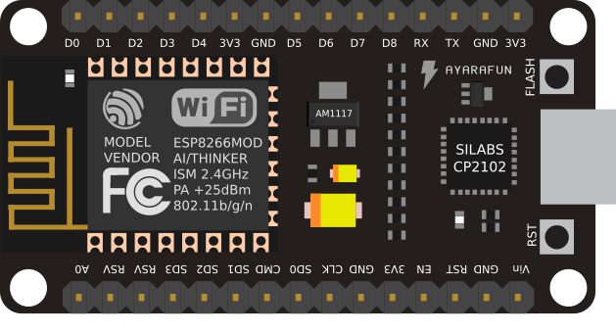
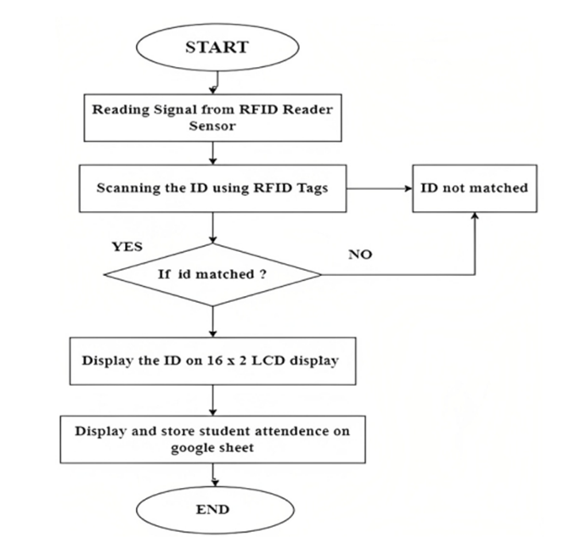
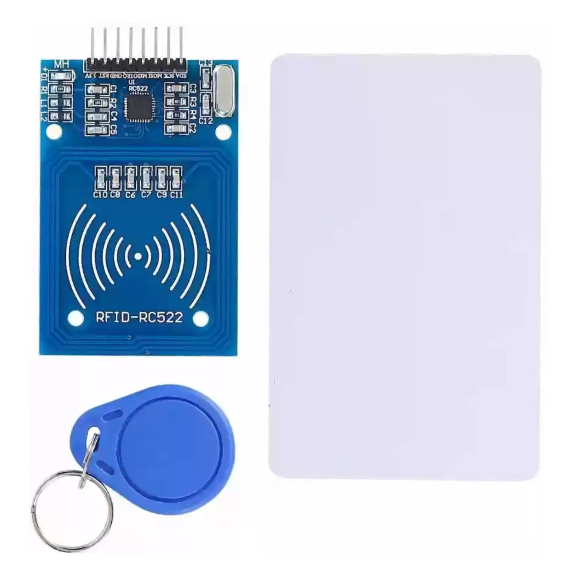
FLOW CHART
07

Slide 8
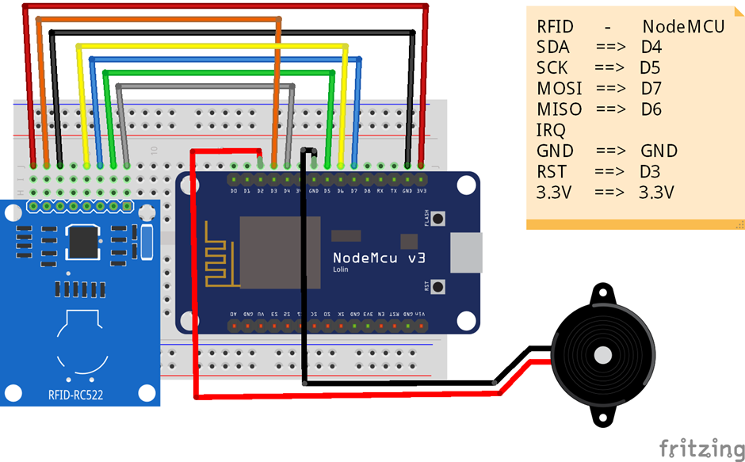
CIRCUIT DIAGRAM
Implementation of circuit diagram of RFID based attendance system
08

Slide 9
IMPLEMENTATION
Phase 1
Phase 2
Phase 3
Starting with the RFID cards , the cards are equipped with data including name , roll number , phone number , address , and others
ESP module connects to internet through Wifi , when an RFID card with details is placed through the RFID reader, it reads them
And a new code is used through ESP 8266 to send the data to apps script through deployment ID
09

Slide 10
IMPLEMENTATION
Phase 4
Phase 5
Phase 6
App script sends the data of student along with time and date to different columns present in the google sheet
If you are already present in the particular class or room then upon placing the card your exit time will be recorded
Upon reading the data , it is transmitted to apps script through internet
10

Slide 11
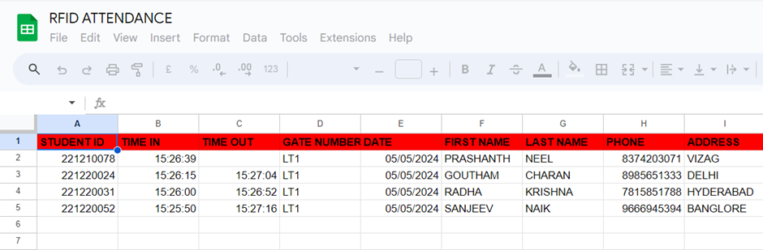
RESULT
11

Slide 12
RESULT:
Increased Efficiency: The project resulted in a significant increase in efficiency in attendance management. By leveraging RFID technology, the process of data collection was automated, eliminating the need for manual entry and reducing the likelihood of errors.
Real-time Tracking: With the implementation of RFID tags and readers, real-time tracking of attendance data became feasible. As a result, administrators and supervisors gained access to up-to-date information on attendance status, allowing for prompt decision-making and intervention when necessary.
Enhanced Accuracy: The utilization of RFID technology ensured enhanced accuracy in attendance tracking. The system reliably captured information from RFID tags, including roll numbers, names, locations, and affiliations, minimizing inaccuracies often associated with manual entry methods.
12

Slide 13

CONCLUSIONS
Automation of data collection through RFID tags and readers minimizes manual efforts, leading to streamlined processes.
RFID readers capture essential information such as roll numbers, names, and timestamps, providing a comprehensive record of attendance data.
The integration of RFID technology with Google Sheets enables real-time monitoring and analysis of attendance data.
The implementation of RFID-based attendance systems enhances security measures within organizations.
Whether in educational institutions or workplaces, the system can accommodate changes in attendance policies and organizational structures.
13

Slide 14

FUTURE SCOPE OF PROJECT
Sensor Integration: Embed additional sensors in the tags to capture environmental data like temperature, humidity, or light levels.
Real-Time Data Visualization: Develop a dashboard that displays real-time data collected from the tags.
Blockchain Integration: Explore leveraging blockchain technology to create an immutable record of data collected from the tags.
Interactive NFC Applications: Design NFC interactions to be more engaging. Imagine tapping an NFC tag on a piece of equipment to access instructional videos or initiate maintenance requests.
14

Slide 15
REFERENCES
[1] Priyanka verma, Dharmender verma, Pushpender , Review of attendance monitoring system based on RFID , IJTRS , 2015.
[2] Hasanein D. Rjeib , Nabeel Salih Ali, Ali Al Farawn, Basheer AlSadawi, Haider Alsharqi ,Attendance and Information System using RFID and Web-Based Application for Academic Sector , 2018.
[3] M. Mustapha*, M. Abdulkadir, M. A. Sarki and S. P. Omale , RFID Based Student Attendance Monitoring System with GSM Module Incorporated, 2018.
[4] O.K. Oyetola, A.A. Okubanjo , O.O Olaluwoye , A Secure Students Attendance Monitoring System , 2017.
[5] Arulogun O. T., Olatunbosun, A., Fakolujo O. A., and Olaniyi, O. M., RFID-Based Students Attendance Management System , 2013.
[6] Samuel King Opoku, March 2013, “An automated biometric attendance management system,” International Journal of Computer Science and Mobile Computing., Vol. 2, Issue. 3, pp.18 – 25.
[7] Elima Hussain , Priyanka Dugar, Vaskar Deka, Abdul Hannan , RFID based Student Attendance System , 2014.
[8] Parvathy, V. R. Raj and M. Reddy, (2011). “RFID based exam hall maintenance system”, IJCA Special Issue on Artificial Intelligence Techniques-Novel Approaches & Practical Applications (AIT).
15

Slide 16
REFERENCES
[9] Joseph Dedy Irawan, Emmalia Adriantantri , and Akh Farid, RFID and IOT for Attendance Monitoring System , MATEC Web of Conferences 164, 01020 , 2018.
[10] S. Nainan, R. Parekh, T. Shah. IJCSI, 10,1(2013).
[11] O.G., Chiagozie, O.G. Nwaji, Radio Frequency Identification based attendance system with automatic door unit, Academic Research International, 2,2:168–183 , 2012.
[12] H.M. Nguyen D.T. Le, S. Heo, J. Im, D. Kim, Optimizations for RFID-based IoT applications on the Cloud, 2015
[13] Mobile Based Attendance Marking System Using Android And Biometrics- Mr. Gautam Shanbhag, Mr. Hussain Jivani (IJIRST– International Journal for Innovative Research in Science &Technology| Vol. 1, Issue 1, June 2014| ISSN (online): 2349-6010
[14] Development of Smartphone-based Student Attendance System- Md. Milon Islam, Md. Kamrul Hasan, Md Masum Billah, and Md. Manik Uddin (2017 IEEE Region 10 Humanitarian Technology Conference (R10-HTC) 21 - 23 Dec 2017, Dhaka, Bangladesh)
[15] Nirmalya Kar and Ashim Saha; Study of implementing automated attendance system using face recognition technique; International Journal of computer and communication engineering, Vol. 1, No. 2, July 2012
16

Slide 17

THANK
YOU
Presented by Goutham Sri Charan Mekala

